Slide 1
GRADE 7 ACCELERATED · UNIT 4 · LESSONS 2–3
Multiplying and Dividing in Scientific Notation
MA.8.NSO.1.5
I can multiply and divide two numbers written in scientific notation, and write the answer in scientific notation.
Yesterday the powers of ten had to match before you could add.
Today they do not have to match at all — and they can be as far apart as they like.
Grade 7 Accelerated · Unit 4 · Lessons 2–3 — Multiplying and Dividing in Scientific Notation
1

Slide 2
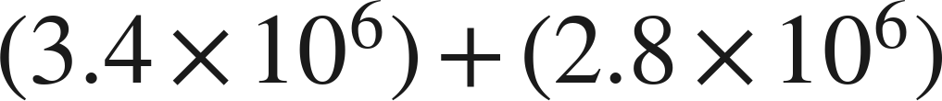
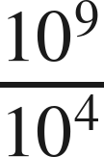
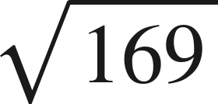

Warm-Up
On your own. Four minutes. No notes.
1.
2. Write as one power:
3. Find the value:
4. Find the quotient:
Grade 7 Accelerated · Unit 4 · Lessons 2–3 — Multiplying and Dividing in Scientific Notation
2

Slide 3
Warm-Up
Answers.
1.
6.2 × 10⁶
2. Write as one power:
10⁵
3. Find the value:
13
4. Find the quotient:
3
Grade 7 Accelerated · Unit 4 · Lessons 2–3 — Multiplying and Dividing in Scientific Notation
3

Slide 4
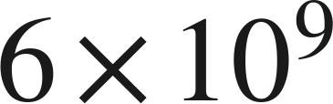
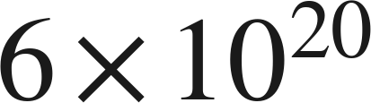
Notes
Copy both lines.
I. Multiplying: regroup, then use the laws
, never
Multiply the coefficients. Add the exponents — that is the product of powers law, not a new rule.
Grade 7 Accelerated · Unit 4 · Lessons 2–3 — Multiplying and Dividing in Scientific Notation
4

Slide 5
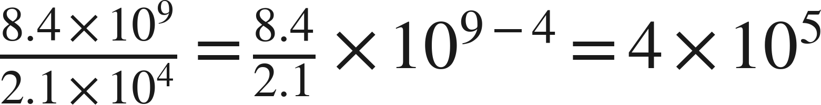
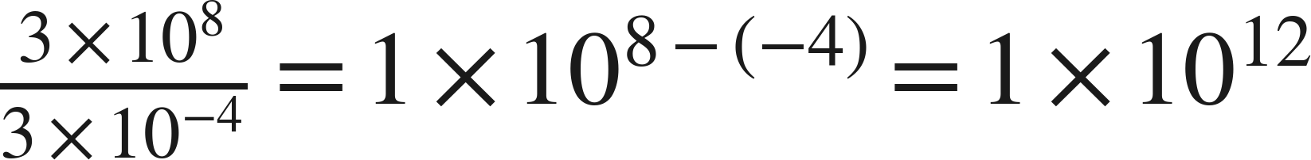
Notes
II. Dividing: the same move with the quotient law
Divide the coefficients. Subtract the exponents, top minus bottom.
Grade 7 Accelerated · Unit 4 · Lessons 2–3 — Multiplying and Dividing in Scientific Notation
5

Slide 6
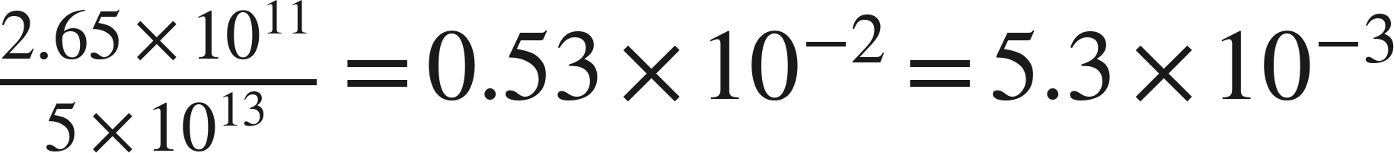
Notes
III. Finish the answer — both directions
Every answer ends with a coefficient at least 1 and less than 10.
Grade 7 Accelerated · Unit 4 · Lessons 2–3 — Multiplying and Dividing in Scientific Notation
6

Slide 7
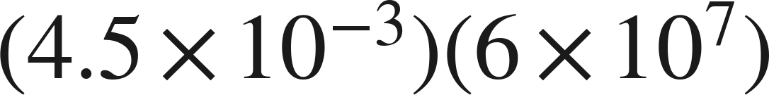
Example 1
Multiplying, and the answer needs finishing.
Multiply. Write the answer in scientific notation.
Grade 7 Accelerated · Unit 4 · Lessons 2–3 — Multiplying and Dividing in Scientific Notation
7

Slide 8
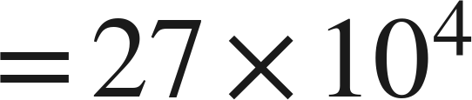
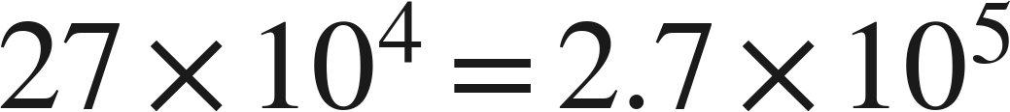
Example 1
Worked.
regroup
multiply the coefficients, add the exponents
27 is not less than 10: point one place left, exponent up one
Answer: 2.7 × 10⁵
Grade 7 Accelerated · Unit 4 · Lessons 2–3 — Multiplying and Dividing in Scientific Notation
8

Slide 9
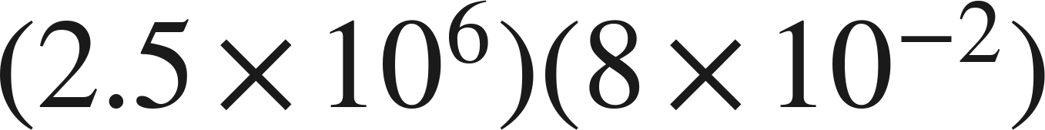
Your Turn
Same steps, your numbers. Boards up when done.
Grade 7 Accelerated · Unit 4 · Lessons 2–3 — Multiplying and Dividing in Scientific Notation
9

Slide 10
Your Turn
Answer.
20 × 10⁴, then repair
Answer: 2 × 10⁵
Grade 7 Accelerated · Unit 4 · Lessons 2–3 — Multiplying and Dividing in Scientific Notation
10

Slide 11
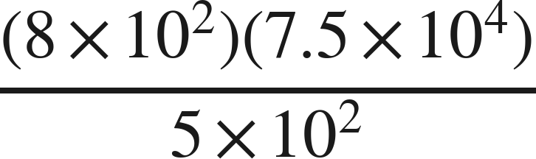
Example 2
Multiplication and division in one expression.
Evaluate. Write the answer in scientific notation.
Grade 7 Accelerated · Unit 4 · Lessons 2–3 — Multiplying and Dividing in Scientific Notation
11

Slide 12
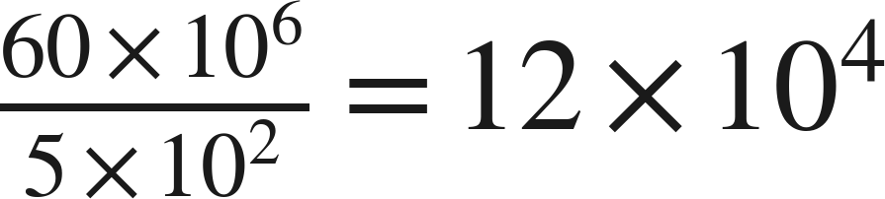
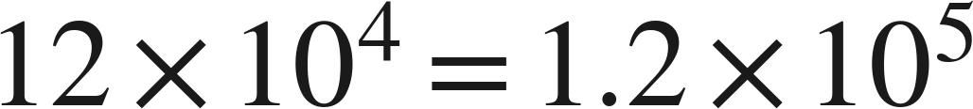
Example 2
Worked.
the top, regrouped
divide the coefficients, subtract the exponents
finish
Answer: 1.2 × 10⁵
Grade 7 Accelerated · Unit 4 · Lessons 2–3 — Multiplying and Dividing in Scientific Notation
12

Slide 13
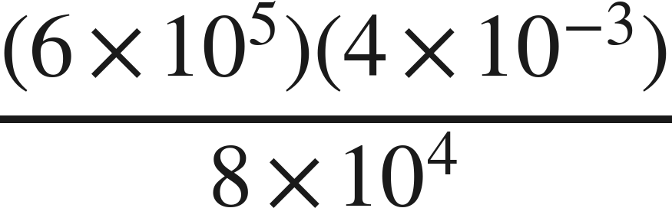
Your Turn
Same steps, your numbers. Boards up when done.
Grade 7 Accelerated · Unit 4 · Lessons 2–3 — Multiplying and Dividing in Scientific Notation
13

Slide 14
Your Turn
Answer.
24 × 10² over 8 × 10⁴
Answer: 3 × 10⁻²
Grade 7 Accelerated · Unit 4 · Lessons 2–3 — Multiplying and Dividing in Scientific Notation
14

Slide 15
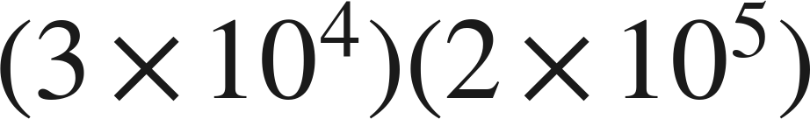
Whiteboards · Question 1 of 9
Boards up on three.
Answer it.
Multiply the fronts, add the backs.
Grade 7 Accelerated · Unit 4 · Lessons 2–3 — Multiplying and Dividing in Scientific Notation
15

Slide 16
Whiteboards · Question 1 of 9
Answer.
3 · 2 and 10⁴ · 10⁵
Answer: 6 × 10⁹
Grade 7 Accelerated · Unit 4 · Lessons 2–3 — Multiplying and Dividing in Scientific Notation
16

Slide 17
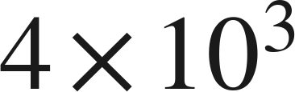
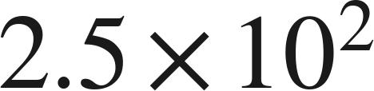
Whiteboards · Question 2 of 9
Boards up on three.
A printer makes
copies per hour.
It runs for
hours. Paper costs 3 cents a sheet.
How many copies does it make?
Answer it.
Rate times time.
Grade 7 Accelerated · Unit 4 · Lessons 2–3 — Multiplying and Dividing in Scientific Notation
17

Slide 18
Whiteboards · Question 2 of 9
Answer.
A printer makes
copies per hour.
It runs for
hours. Paper costs 3 cents a sheet.
How many copies does it make?
10 × 10⁵, then finish
Answer: 1 × 10⁶
Grade 7 Accelerated · Unit 4 · Lessons 2–3 — Multiplying and Dividing in Scientific Notation
18

Slide 19
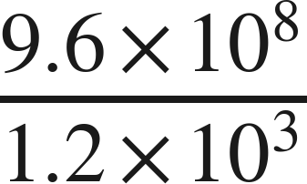
Whiteboards · Question 3 of 9
Boards up on three.
Answer it.
Top minus bottom.
Grade 7 Accelerated · Unit 4 · Lessons 2–3 — Multiplying and Dividing in Scientific Notation
19

Slide 20
Whiteboards · Question 3 of 9
Answer.
9.6 ÷ 1.2 and 10⁸ ÷ 10³
Answer: 8 × 10⁵
Grade 7 Accelerated · Unit 4 · Lessons 2–3 — Multiplying and Dividing in Scientific Notation
20

Slide 21
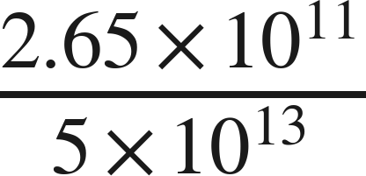
Whiteboards · Question 4 of 9
Boards up on three.
Answer it.
Finish the answer.
Grade 7 Accelerated · Unit 4 · Lessons 2–3 — Multiplying and Dividing in Scientific Notation
21

Slide 22
Whiteboards · Question 4 of 9
Answer.
0.53 × 10⁻² is not finished
Answer: 5.3 × 10⁻³
Grade 7 Accelerated · Unit 4 · Lessons 2–3 — Multiplying and Dividing in Scientific Notation
22

Slide 23
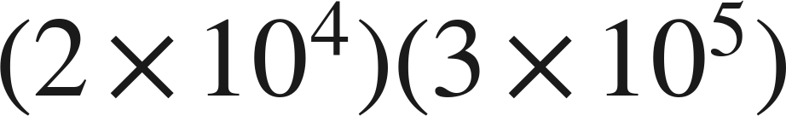
Whiteboards · Question 5 of 9
Boards up on three.
Which is the product?
A. 6 × 10⁹
B. 6 × 10²⁰
C. 5 × 10⁹
D. 6 × 10¹
Answer it.
Grade 7 Accelerated · Unit 4 · Lessons 2–3 — Multiplying and Dividing in Scientific Notation
23

Slide 24
Whiteboards · Question 5 of 9
Answer.
Which is the product?
A. 6 × 10⁹
B. 6 × 10²⁰
C. 5 × 10⁹
D. 6 × 10¹
Answer: A — 6 × 10⁹
Grade 7 Accelerated · Unit 4 · Lessons 2–3 — Multiplying and Dividing in Scientific Notation
24

Slide 25
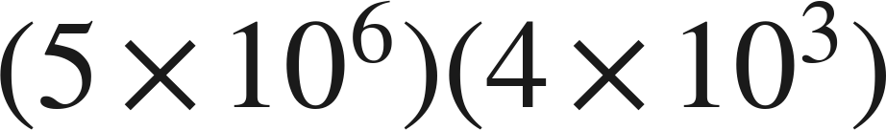
Whiteboards · Question 6 of 9
Boards up on three.
Which is the product, written in scientific notation?
A. 2 × 10¹⁰
B. 20 × 10⁹
C. 2 × 10⁹
D. 20 × 10¹⁸
Answer it.
Grade 7 Accelerated · Unit 4 · Lessons 2–3 — Multiplying and Dividing in Scientific Notation
25

Slide 26
Whiteboards · Question 6 of 9
Answer.
Which is the product, written in scientific notation?
A. 2 × 10¹⁰
B. 20 × 10⁹
C. 2 × 10⁹
D. 20 × 10¹⁸
Answer: A — 2 × 10¹⁰
Grade 7 Accelerated · Unit 4 · Lessons 2–3 — Multiplying and Dividing in Scientific Notation
26

Slide 27
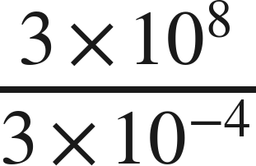
Whiteboards · Question 7 of 9
Boards up on three.
Answer it.
Top minus bottom, and the bottom is negative.
Grade 7 Accelerated · Unit 4 · Lessons 2–3 — Multiplying and Dividing in Scientific Notation
27

Slide 28
Whiteboards · Question 7 of 9
Answer.
8 − (−4) = 12
Answer: 1 × 10¹²
Grade 7 Accelerated · Unit 4 · Lessons 2–3 — Multiplying and Dividing in Scientific Notation
28

Slide 29
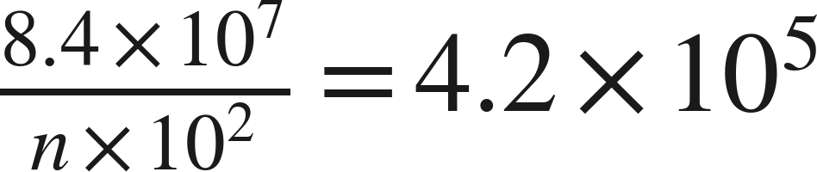

Whiteboards · Question 8 of 9
Boards up on three.
What is the value of
?
Answer it.
Look at the coefficients alone.
Grade 7 Accelerated · Unit 4 · Lessons 2–3 — Multiplying and Dividing in Scientific Notation
29

Slide 30
Whiteboards · Question 8 of 9
Answer.
What is the value of
?
8.4 ÷ n = 4.2
Answer: n = 2
Grade 7 Accelerated · Unit 4 · Lessons 2–3 — Multiplying and Dividing in Scientific Notation
30

Slide 31
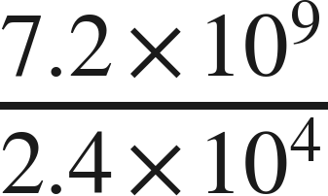
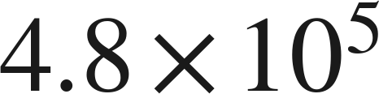
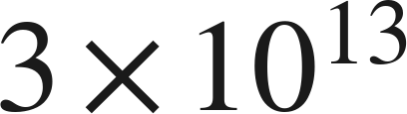
Whiteboards · Question 9 of 9
Take your time. Boards up when you have written it.
For
Marcus writes
and Sara writes
Name what each one did wrong, and give the correct quotient.
Write your answer in sentences.
Each one got exactly one half right.
Grade 7 Accelerated · Unit 4 · Lessons 2–3 — Multiplying and Dividing in Scientific Notation
31

Slide 32
Whiteboards · Question 9 of 9
Answer.
For
Marcus writes
and Sara writes
Name what each one did wrong, and give the correct quotient.
one wrong in front, one wrong behind
Answer: 3 × 10⁵
Grade 7 Accelerated · Unit 4 · Lessons 2–3 — Multiplying and Dividing in Scientific Notation
32

Slide 33
Independent Set
Six questions. On your own, in silence.
1.
Six questions. Work down the page.
2.
Show the step that does the work, not just the answer.
3.
Silence until the six minutes are up.
Grade 7 Accelerated · Unit 4 · Lessons 2–3 — Multiplying and Dividing in Scientific Notation
33

Slide 34
IXL
Last five minutes.
1.
Open IXL and start today's skills.
2.
Work on paper where the question needs work. The answer box does not show it.
3.
Every skill listed is required, to a SmartScore of 67. Due at the start of the next class.
Today's skills — all required
Multiply numbers written in scientific notation — YZU
Divide numbers written in scientific notation — SGT
Grade 7 Accelerated · Unit 4 · Lessons 2–3 — Multiplying and Dividing in Scientific Notation
34

